Slide 1
Class : Game Playing
Joshua Durso-Finley Course code:
joshua.durso-finley@mail.mcgill.ca

Slide 2
Outline

Slide 3

Table of Contents
Why games?
Overview
Game theory
Minimax
Evaluation functions
Alpha Beta pruning
Notes:
‹#›

Slide 4
Game playing
One of the oldest domains studied in AI
Complex but solvable
Clear description of environment
Often thought of as requiring intelligence to play
Notes:
‹#›

Slide 5
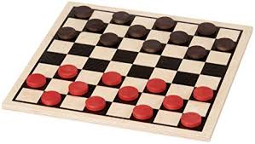
Solved games
Optimal Strategy is known for all positions
Strongly solved: all positions
Weakly solved: some (starting) positions
Notes:
‹#›

Slide 6
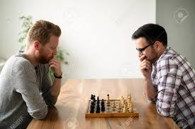
Typical games
2-Player
Alternating
Zero-Sum
Perfect Information
Notes:
‹#›

Slide 7
Typical Games
Very similar to search
Set of possible states
Starting state
Successor function
Terminal/Goal States
Objective function
The difference is alternating control
Notes:
‹#›

Slide 8
Typical Games
Search Game playing
Our turn
Our turn
Their turn
Our turn
Our turn
Our turn
Their turn
Our turn
Notes:
‹#›

Slide 9
Games
Search Game playing
Our turn
Our turn
Their turn
Our turn
Our turn
Our turn
Their turn
Our turn
How do we use this structure to figure out moves to play?
Notes:
‹#›

Slide 10
Minimax
In a zero sum game our loss is directly their gain!
If we maximize our objective function the opponent wants to minimize
Our turn-Maximize objective
Their turn-Minimize our objective
Our turn-Maximize objective
Their turn-Minimize our objective
Notes:
‹#›

Slide 11
Minimax
Since rewards are only given at the end we must run all the way to the bottom of a game before we can propagate the result
Our turn-Maximize objective
Their turn-Minimize our objective
Our turn-Maximize objective
Their turn-Minimize our objective
Notes:
‹#›

Slide 12
Minimax
What should go in the circle on the left?
Our turn-Maximize objective
Their turn-Minimize our objective
Our turn-Maximize objective
Their turn-Minimize our objective
Notes:
‹#›

Slide 13
Minimax
What should go in the circle on the left?
Our turn-Maximize objective
Their turn-Minimize our objective
Our turn-Maximize objective
Their turn-Minimize our objective
Notes:
‹#›

Slide 14
Minimax
What should go in the circle on the right?
Our turn-Maximize objective
Their turn-Minimize our objective
Our turn-Maximize objective
Their turn-Minimize our objective
Notes:
‹#›

Slide 15
Minimax
What should go in the circle on the right?
Our turn-Maximize objective
Their turn-Minimize our objective
Our turn-Maximize objective
Their turn-Minimize our objective
Notes:
‹#›

Slide 16
Minimax
The full tree propagates back to the beginning
Make our decision by which of the children of the root has the most promising path
Our turn-Maximize objective
Their turn-Minimize our objective
Our turn-Maximize objective
Their turn-Minimize our objective
Notes:
‹#›

Slide 17
Minimax algorithm
Compute values for each node in the search graph
If it is a goal node record the score
If it is not a goal node select the largest score if you are the maximizing player and the smallest score if you are the minimizing player
Start from the bottom of the tree and work your way up
What kind of traversal is this?
Notes:
‹#›

Slide 18
Minimax algorithm properties
Optimal for both players-In the zero sum game case
Time complexity O(b^d)
Space complexity (b^d)
We are forced to evaluate the entire tree
Notes:
‹#›

Slide 19
Example
10
5
-5
2
-3
20
Notes:
‹#›

Slide 20
Example
5
-5
-3
10
5
-5
2
-3
20
Notes:
‹#›

Slide 21
Example
5
5
-5
-3
10
5
-5
2
-3
20
Notes:
‹#›

Slide 22
Complete the first exercise
Code minimax for tic-tac-toe
Notes:
‹#›

Slide 23
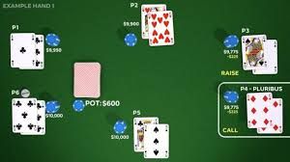
Variations of minimax
Games of chance
Notes:
‹#›

Slide 24
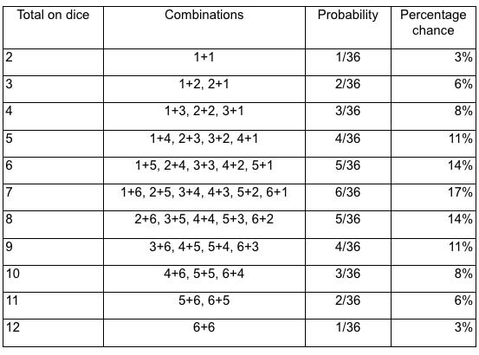
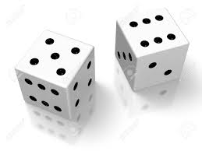
Expectimax
Stochastic outcomes are determined at random
Notes:
‹#›

Slide 25
Expectimax
How do we factor in stochasticity?
Notes:
‹#›

Slide 26
Expectimax
How do we factor in stochasticity?
Agent doesn’t get to choose
Selecting the max value is optimistic
Selecting the minimum value is pessimistic
Insert a random player layer
Notes:
‹#›

Slide 27
Expectimax
Multiply the quality of the node by the probability of the node occurring i.e. compute the expected value of being in that position
Our turn-Maximize objective
Their turn-Minimize our objective
Random turn
Our turn-maximize objective
Notes:
‹#›

Slide 28
Variations of minimax
Minimax never reaches the absolute bottom of the game
Time is O(b^d)
For games like Go which last 100s of moves and there are many possible moves at each state this method will never find a solution
Notes:
‹#›

Slide 29
Alpha-Beta Pruning
Proposal we can figure out earlier whether or not we want to explore the entire branch after seeing a few possible resolutions of the game
This could reduce the amount of nodes by a considerable amount!
Notes:
‹#›

Slide 30
Alpha-Beta Pruning
Could we eliminate any nodes?
5
5
-5
-3
10
5
-5
2
-3
20
Notes:
‹#›

Slide 31
Alpha-Beta Pruning
Works across three levels.
We must explore one full branch of the topmost level.
5
5
10
5
-5
-3
20
Notes:
‹#›

Slide 32
Alpha-Beta Pruning
During our exploration of the middle branch we see a -3. Is there any possible value which would entice us to chose the middle branch if we are player 1?
5
Max
5
Min
10
5
-5
-3
20
Notes:
‹#›

Slide 33
Alpha-Beta Pruning
No! The node is at best going to return -3 which is worse than 5 so we no longer need to explore along that node.
5
Max
5
Min
10
5
-5
-3
20
Notes:
‹#›

Slide 34
Alpha-Beta Pruning
What about after we’ve seen the -5 from the branch on the right?
5
Max
5
Min
10
5
-5
-3
20
Notes:
‹#›

Slide 35
Alpha-Beta Pruning
What about after we’ve seen the -5 from the branch on the right?
5
Max
5
Min
10
5
-5
-3
20
Notes:
‹#›

Slide 36
Alpha-Beta Pruning
Can remove all children
5
Max
5
Min
-3
10
5
-3
20
-9
Notes:
‹#›

Slide 37
Alpha-Beta Pruning
This works for the minimizing player at the top
10
Min
10
max
10
5
20
21
-9
Notes:
‹#›

Slide 38
Alpha-Beta Pruning
After exploring the left branch we see a 10. In our first exploration along the middle branch we see a 20. Do we need to see the remaining values?
10
Min
10
max
10
5
20
21
-9
Notes:
‹#›

Slide 39
Alpha-Beta Pruning
After exploring the left branch we see a 10. In our first exploration along the middle branch we see a 20. Do we need to see the remaining values?
10
Min
10
max
10
5
20
21
-9
Notes:
‹#›

Slide 40
Alpha-Beta Pruning
More generally α is the highest max β is the lowest min
If we are at a max node and value>=β then prune
If we are at a min node and value<=α then prune
10
Min
10
max
10
5
20
21
-9
Notes:
‹#›

Slide 41
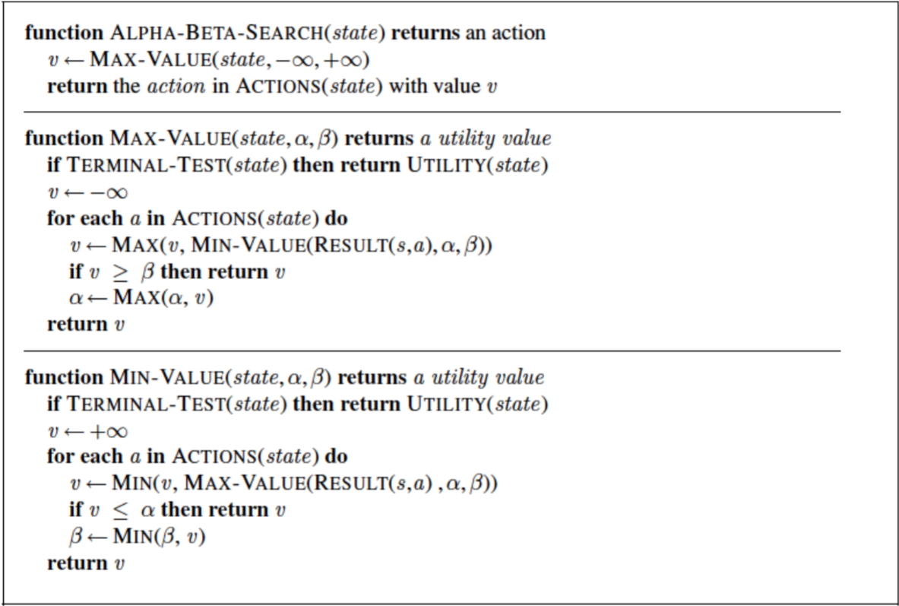
Alpha-Beta Pruning
Notes:
‹#›

Slide 42
Activity
Fill out AB-pruning for tic-tac-toe and compare the number of nodes opened
http://homepage.ufp.pt/jtorres/ensino/ia/alfabeta.html For simulations
10
Min
10
max
10
5
20
21
-9
Notes:
‹#›

Slide 43
AB-pruning in practice
AB-Pruning creates expert players but in the worst case it still needs to explore every node
We need a solution that can work reasonably quickly
Instead of evaluating to the end approximate the value of a state with a heuristic
Notes:
‹#›

Slide 44
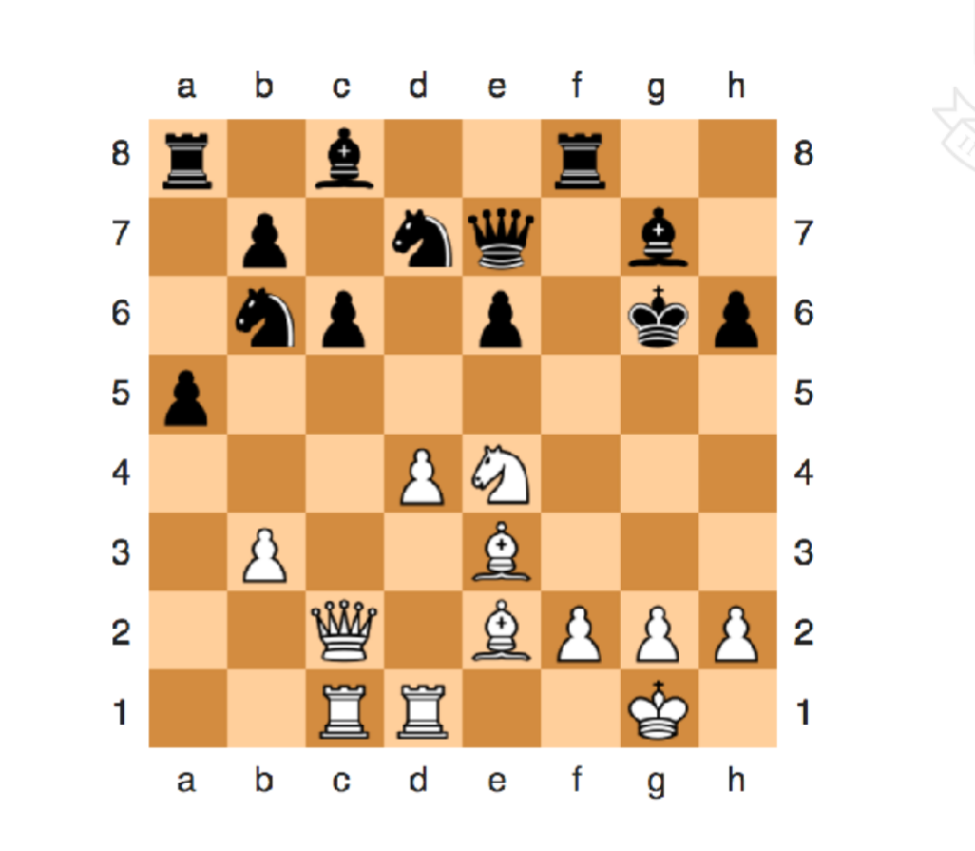
Evaluation Functions
Notes:
‹#›

Slide 45
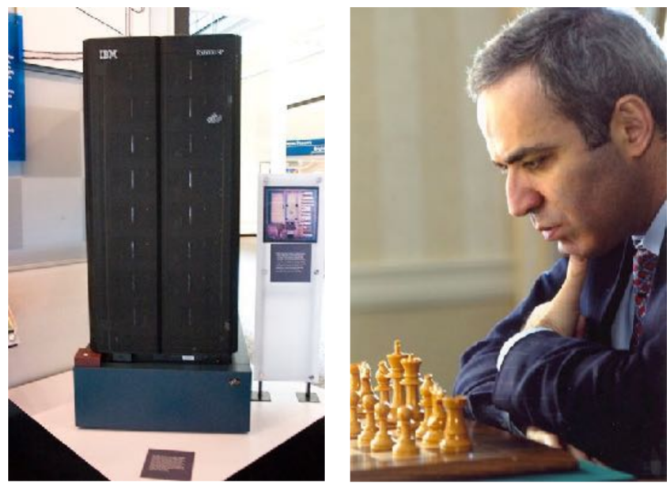
Deep Blue
Search depth 6-8
200 million positions/sec
Stock fish 700 million positions/sec
Notes:
‹#›

Slide 46
Problems
Horizon effect what if something bad happens at max depth +1?
How far and how deep should we expand a node?
How do we allocate fixed move time?
Notes:
‹#›

Slide 47
Problems
Need to be addressed in the project
Notes:
‹#›

Slide 48
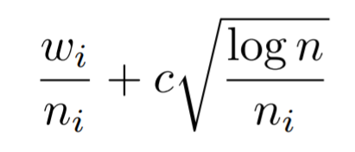
Monte-Carlo Tree Search
Rather than searching at a fixed depth expand some nodes more than others
Trade off expanding unexplored nodes and promising nodes
Notes:
‹#›

Slide 49
Monte-Carlo Tree Search
Allows you to go deeper and explore nodes you care about more
Notes:
‹#›

Slide 50
Monte-Carlo Tree Search
Allows you to go deeper and explore nodes you care about more
Notes:
‹#›

Slide 51
What’s next for games?
Go
Poker
Realtime games
AlphaStar defeats MaNa in starcraft
Not much else… but the research is promising for things like self driving cars
Non-zero sum games
Notes:
‹#›

